Slide 1
C# Access Modifiers
Adrian Gonzalez

Slide 2
CLASS
Classes if not provided with an access modifier, by default they are internal. Default member accessibility are private.
Allowed declared accessibility of the member:
Public
Private
Protected
Internal
Protected Internal
Private Internal

Slide 3
Interface
Interface are internal by default. Default member accessibility are public.
Allowed declared accessibility of the member:
Public
Protected
internal
Private -
An interface member with private accessibility must have a default implementation.
Protected internal
Private protected

Slide 4
Struct
Structs are internal by default. Default member accessibility are private.
Allowed declared accessibility of the member:
Public
internal
Private

Slide 5
What are Access Modifiers in C#?
Access modifiers in C# are used to specify the scope of accessibility for classes,struct,interfaces,fields, methods and properties.
Public
Private
Protected
Internal
Protected Internal
Private Internal

Slide 6
Public Access Modifier
The code is accessible for all classes:
Other assemblies can access this class.
For best practice it’s best NOT TO USE public fields. Unless they are constants.
Notes:
Access is not restricted.

Slide 7
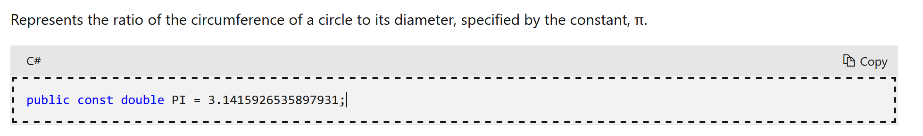
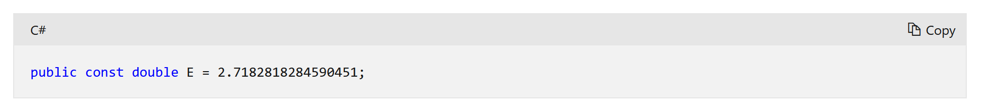
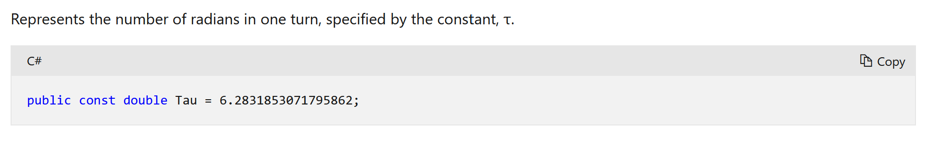
Example of when to use public fields

Slide 8
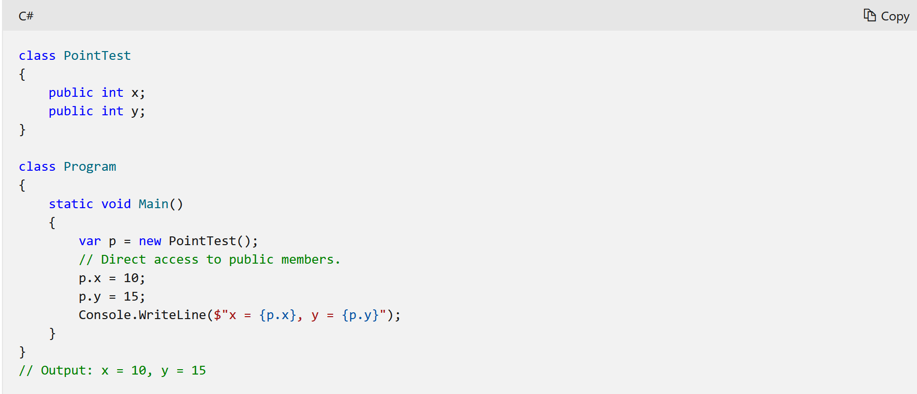
Another Example with classes

Slide 9
Private Access Modifier
The code is only accessible within the same class or the struct in which they are declared. As well as, nested types:
For best practice fields are usually private, hence, which achieves encapsulation.
For methods the only time they are private if it’s only useful within that class and have no use for other classes.
Notes:
Access is limited to the containing type.

Slide 10
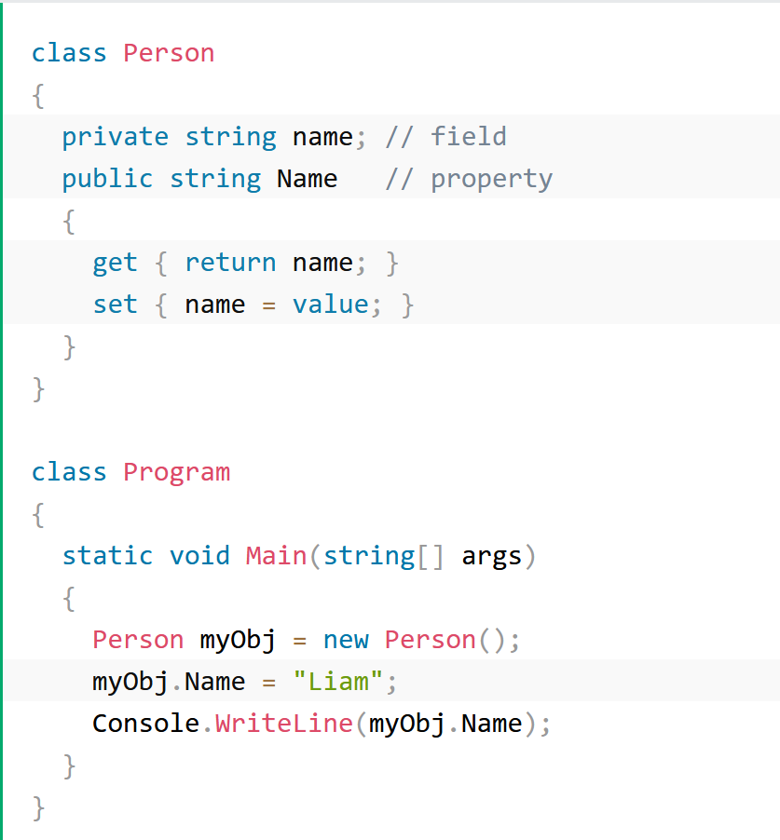
Example of using private modifiers.

Slide 11
Protected Access Modifier
The code is accessible within the same class, or in a class that is inherited from that class:
Your class is designed for inheritance
Notes:
Access is limited to the containing class or types derived from the containing class.

Slide 12
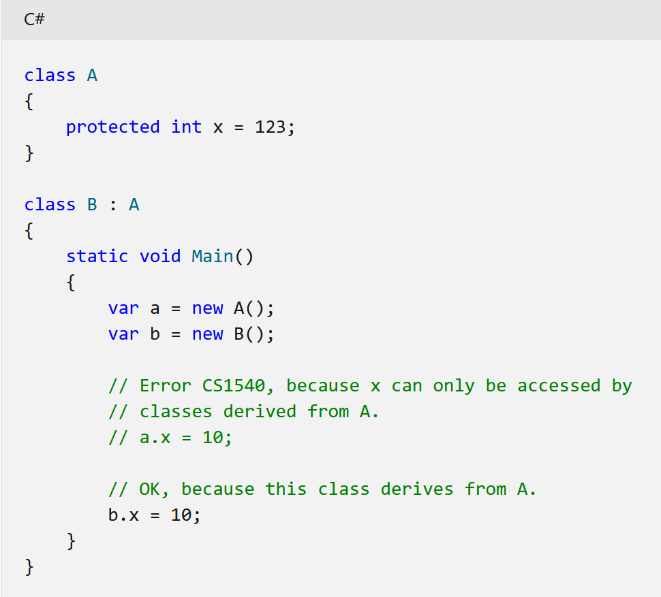
Example of Protected Modifier

Slide 13
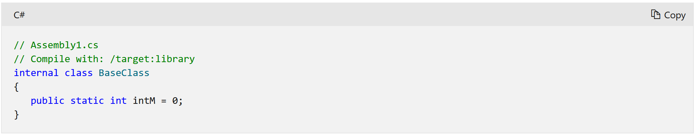
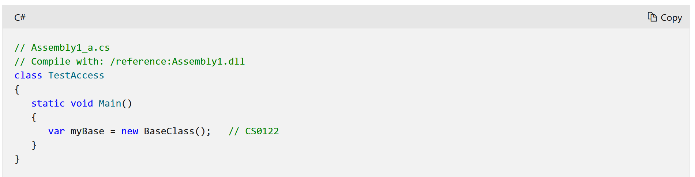
Internal Access Modifier
The code is only accessible within its own assembly, but not from other assemblies. (.exe, .dll):
Great for reusability within the same assembly.
Notes:
A method that is repeating in other classes so you want other classes to use it but don’t want to necessarily want to use it on other assemblies.

Slide 14
Protected Internal Modifier
Access is limited to the current assembly and types derived from the containing class:
An example of this would be if another assembly had a helper method that could be useful in another assembly.
Notes:
Struct members cannot be protected internal because the struct cannot be inherited.
The type or member can be accessed by any code in the assembly in which it is declared, OR from within a derived class in another assembly.

Slide 15
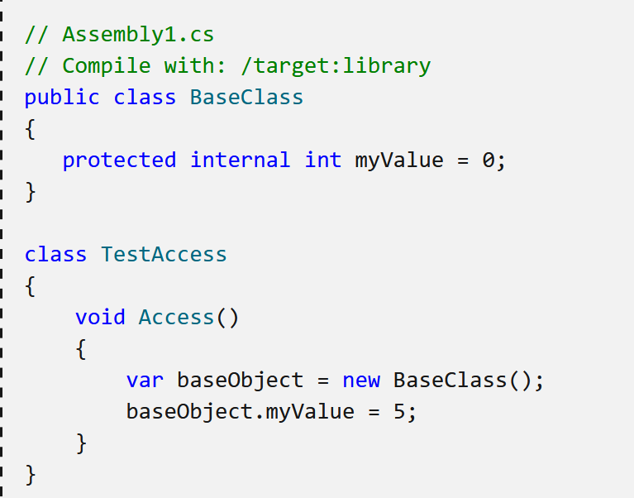
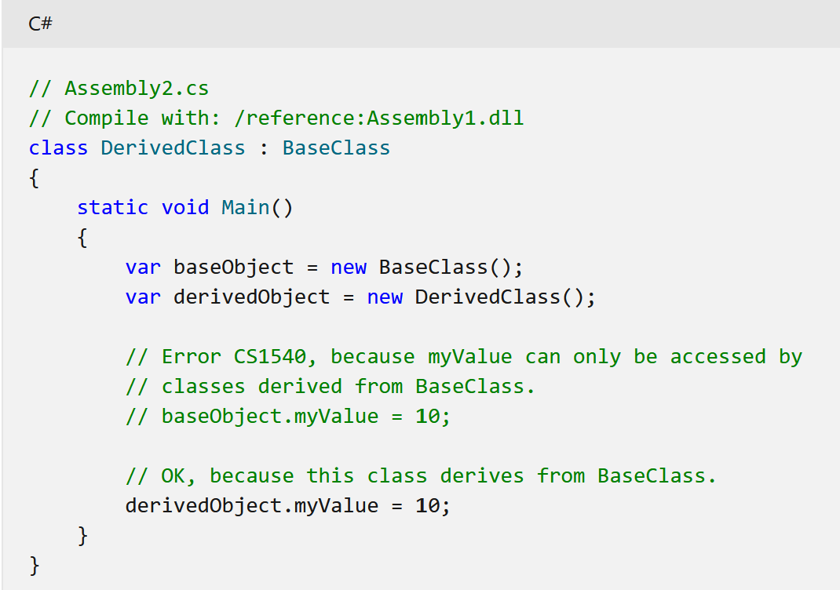
Protected Internal Example

Slide 16
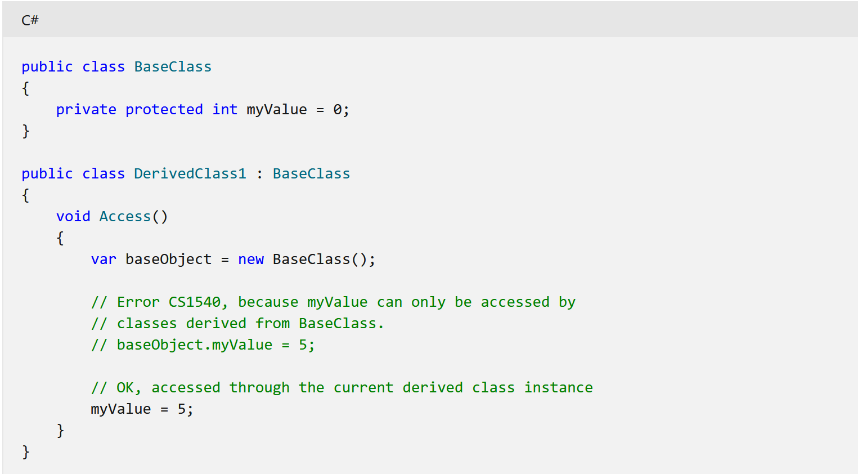
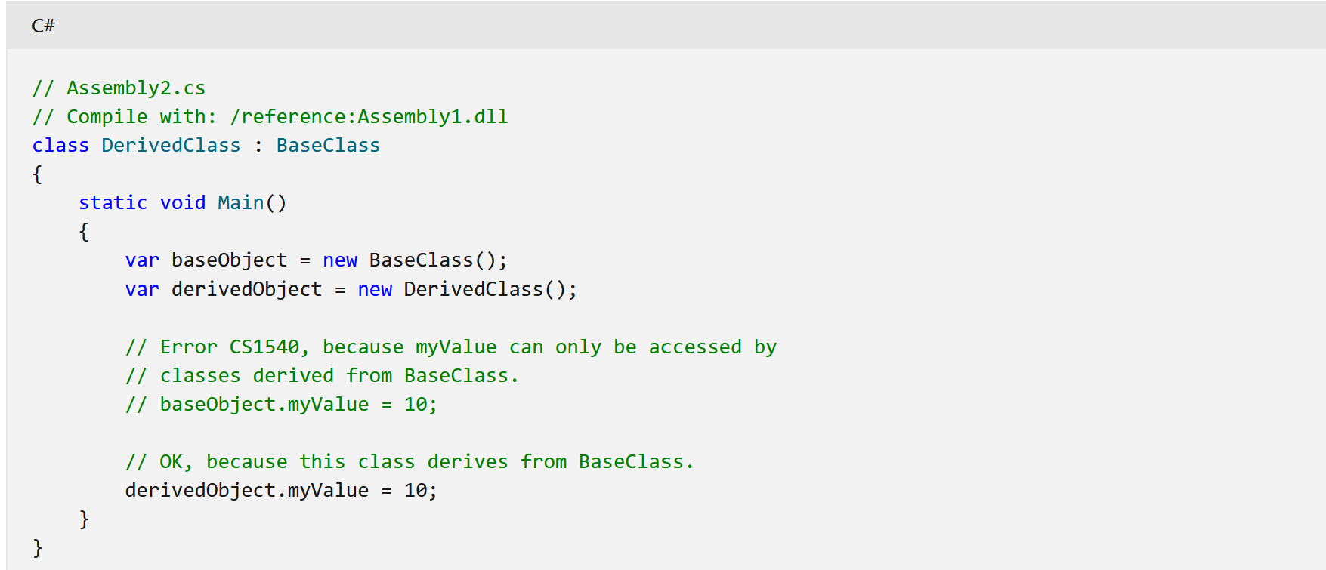
Private Protected Access Modifier
A private protected member is accessible by types derived from the containing class, but only within its containing assembly:
Notes:
Access is limited to the containing class or types derived from the containing class within the current assembly.

Slide 17
Resources
https://www.c-sharpcorner.com/uploadfile/puranindia/what-are-access-modifiers-in-C-Sharp/
https://www.w3schools.com/cs/cs_access_modifiers.php
https://docs.oracle.com/javase/tutorial/java/javaOO/accesscontrol.html
https://stackoverflow.com/questions/17595224/when-i-need-to-use-a-protected-access-modifier

